Slide 1
Chapter 7 Storage

Slide 2
Chapter 7 Objectives
Differentiate among CD-ROMs, recordable CDs, rewritable CDs, DVD-ROMs, BD-ROMs, HD DVD-ROMs, recordable DVDs, and rewritable DVDs
Differentiate between storage devices and storage media
Describe the characteristics of magnetic disks
Describe the characteristics of a hard disk
Identify the uses of tape
Discuss various types of miniature, external, and removable hard disks
Discuss PC Cards, ExpressCard modules, and the various types of miniature mobile storage media
Describe the characteristics of optical discs
Identify uses of microfilm and microfiche
Next

Slide 3
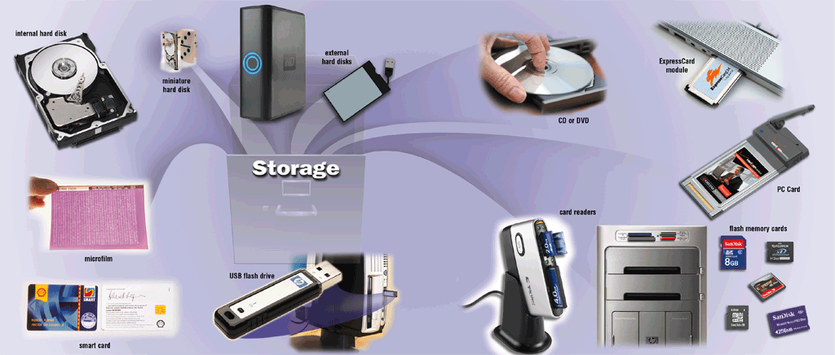
Storage
What is storage?
Holds data, instructions, and information for future use
Storage medium is physical material used for storage
Also called secondary storage
p. 354 - 355 Fig. 7-1
Next

Slide 4
Storage
What is capacity?
Number of bytes (characters) a storage medium can hold
Kilobyte (KB)
1 thousand
Megabyte (MB)
1 million
Gigabyte (GB)
1 billion
Terabyte (TB)
1 trillion
Petabyte (PB)
1 quadrillion
Exabyte (EB)
1 quintillion
Zettabyte (ZB)
1 sextillion
Yottabyte (YB)
1 septillion
p. 356
Next

Slide 5
Storage
How does volatility compare?
Storage medium is nonvolatile—contents retained when power is off
Memory is volatile—holds data and instructions temporarily
ON
OFF
Screen Display
Display appears
Display disappears
Volatile
Memory (most RAM) (chips on motherboard)
Data and instructions available to user
Data and instructions erased
Nonvolatile
Storage Medium (hard disks, CDs, DVDs, USB flash drives, etc.)
Contents available to user
Contents retained
p. 355 - 356
Next

Slide 6
Storage
What is a storage device?
Hardware that records and retrieves items to and from storage media
Reading
Process of transferring items from storage media to memory
Writing
Process of transferring items from memory to storage media
Functions as source of input
Creates output
p. 356
Next

Slide 7
Storage
What is access time?
Time it takes storage device to locate item on storage medium
Time required to deliver item from memory to processor
faster transfer rates
Transfer rates
Stores …
Primary Storage
Memory (most RAM)
Items waiting to be interpreted and executed by the processor
Secondary Storage
Hard Disk
Operating system, application software, user data and information
Flash Memory Cards and USB Flash Drives
Digital pictures or files to be transported
slower transfer rates
CDs and DVDs
Software, backups, movies, music
Tape
Backups
p. 357 Fig. 7-4
Next

Slide 8
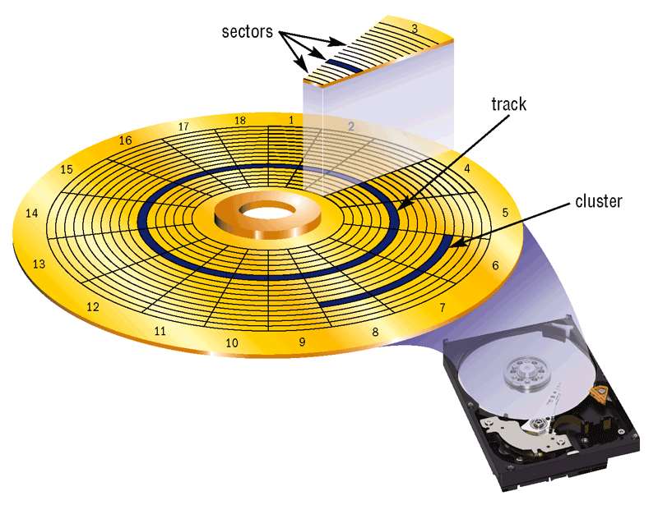
Magnetic Disks
What are tracks and sectors?
Track is narrow recording band that forms full circle on disk
Sector stores up to 512 bytes of data
Formatting prepares disk for use
p. 357 Fig. 7-5
Next

Slide 9
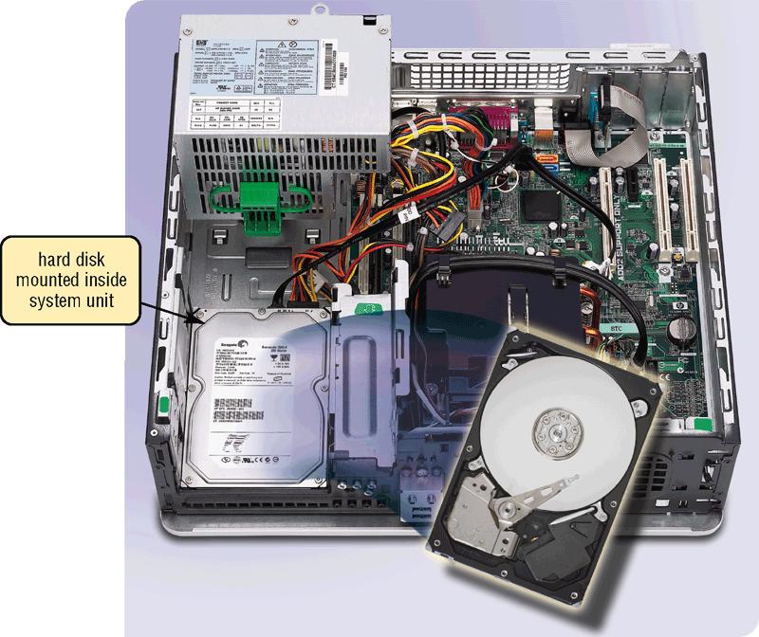
Magnetic Disks
What is a hard disk?
High-capacity storage
Consists of several inflexible, circular platters that store items electronically
Components enclosed in airtight, sealed case for protection
Longitudinal recording
Click to view Web Link, click Chapter 7, Click Web Link from left navigation,
then click Perpendicular Recording below Chapter 7
Perpendicular recording
p. 358 Fig. 7-6
Next

Slide 10
Magnetic Disks
What are characteristics of a hard disk?
Sample Hard Disk Characteristics
Advertised capacity 500 GB
Platters 4
Read/write heads 8
Cylinders 16,383
Bytes per second 512
Sectors per track 63
Sectors per drive 973,773,168
Revolutions per minute 7,200
Transfer rate 300 MBps
Access time 8.5 ms
actual disk capacity
p. 359 Fig. 7-7
Next

Slide 11
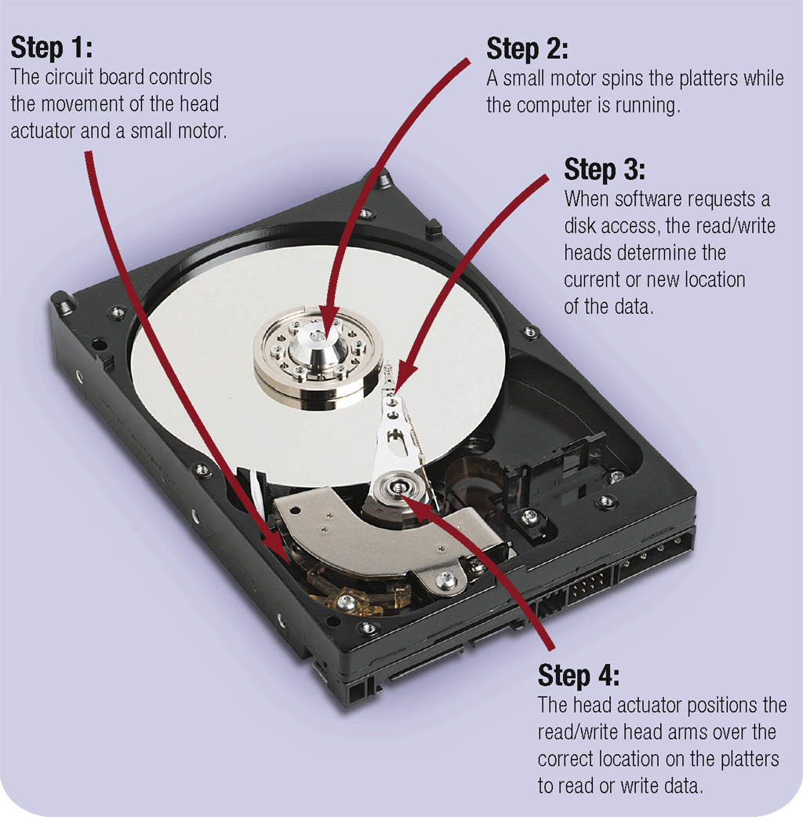
Magnetic Disks
How does a hard disk work?
p. 360 Fig. 7-8
Next

Slide 12
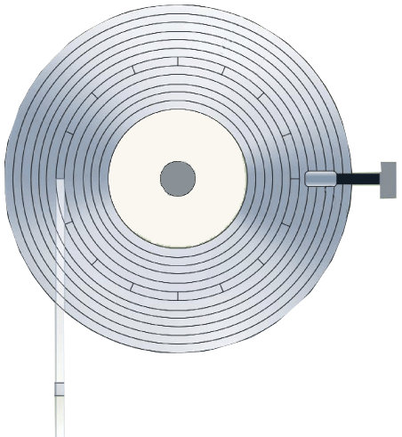
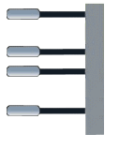
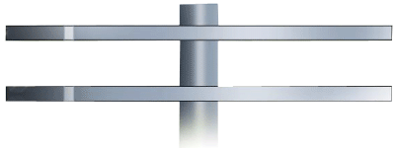
Magnetic Disks
platter
What is a cylinder?
track
Vertical section of track through all platters
sector
Single movement of read/write head arms accesses all platters in cylinder
read/write head
platter
sides
p. 360 Fig. 7-9
cylinder
Next

Slide 13
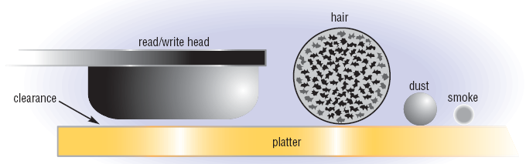
Magnetic Disks
What is a head crash?
Occurs when read/write head touches platter surface
Spinning creates cushion of air that floats read/write head above platter
Clearance between head and platter is approximately two-millionths of an inch
A smoke particle, dust particle, or human hair could render drive unusable
p. 360-361 Fig. 7-10
Next

Slide 14
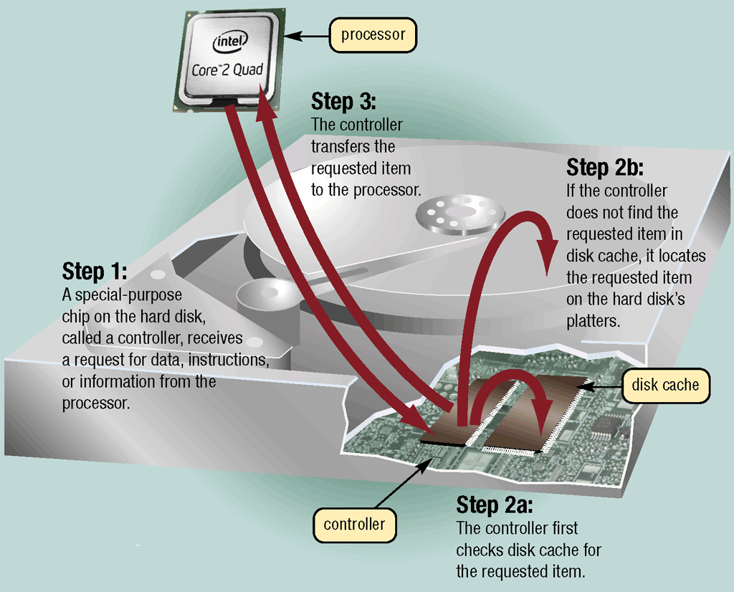
Magnetic Disks
What is a disk cache?
Portion of memory that processor uses to store frequently accessed items
first request for data—to disk cache
second request for data—to hard disk
p. 361 Fig. 7-11
Next

Slide 15
Magnetic Disks
What is RAID?
Redundant Array of Independent Disks
Connects multiple smaller disks into a single unit that acts as a single large hard disk
Click to view Web Link, click Chapter 7, Click Web Link from left navigation, then click RAID below Chapter 7
p. 362
Next

Slide 16

Magnetic Disks
What is a miniature hard disk?
Provide greater storage capacities than flash memory
Smaller than notebook computer hard disks
A pocket hard drive is a self-contained unit
Click to view Web Link, click Chapter 7, Click Web Link from left navigation, then click Pocket Hard Drives below Chapter 7
p. 362 Fig. 7-13
Next

Slide 17
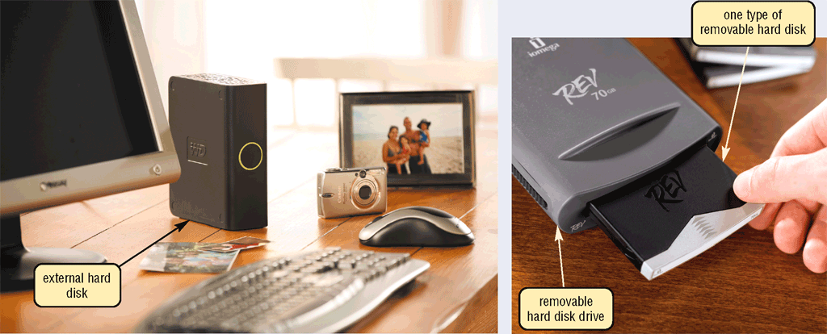
Magnetic Disks
What are external hard disks and removable hard disks?
Used to back up or transfer files
Removable hard disk—hard disk that you insert and remove from hard disk drive
External hard disk—freestanding hard disk that connects to system unit
p. 363 Fig. 7-14
Next

Slide 18
Magnetic Disks
What is a disk controller?
Chip and circuits that control transfer of items from disk
SATA (Serial Advanced Technology Attachment) controller uses serial signals to transfer data, instructions, and information
EIDE (Enhanced Integrated Drive Electronics) controller supports four hard disks, provides connections for CD and DVD drives
SAS controller supports many connected devices at once, including hard disks, CD and DVD drives, printers, scanners, digital cameras, and more
SCSI controller supports up to fifteen devices including hard disks, CD and DVD drives, tape drives, printers, scanners, network cards
Click to view Web Link, click Chapter 7, Click Web Link from left navigation, then click SAS below Chapter 7
p. 363 - 364
Next

Slide 19
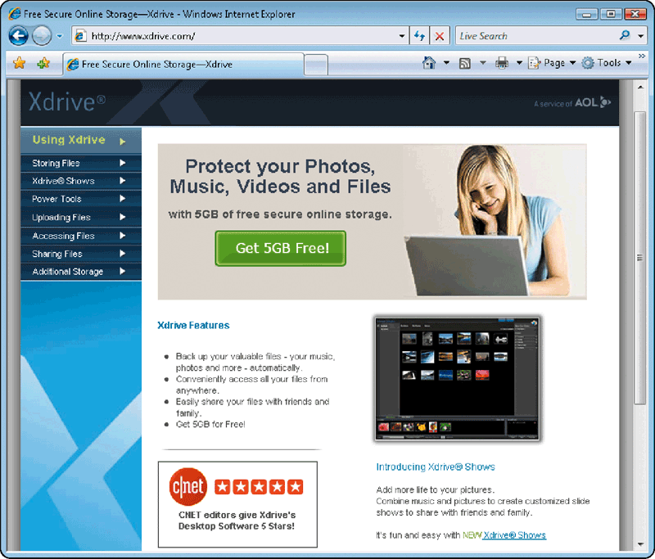
Magnetic Disks
What is online storage?
Service on Web that provides storage for minimal monthly fee
Files can be accessed from any computer with Web access
Large files can be downloaded instantaneously
Others can be authorized to access your data
p. 364 - 365 Fig. 7-15
Next

Slide 20
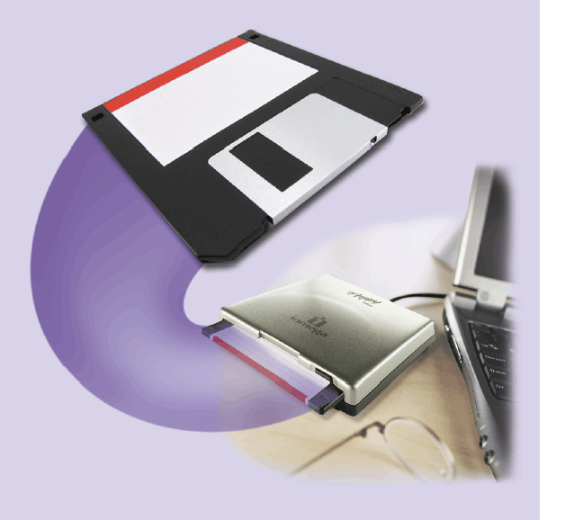
Magnetic Disks
What is a floppy disk?
Portable, inexpensive storage medium (also called diskette)
Thin, circular, flexible film enclosed in 3.5” wide plastic shell
p. 365 Fig. 7-16
Next

Slide 21
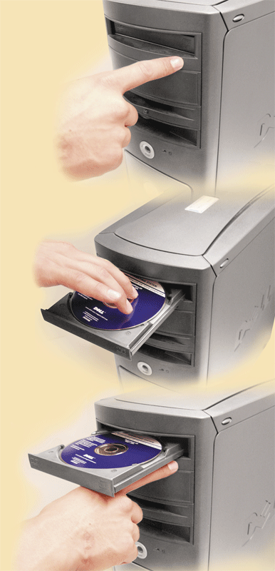
Optical Discs
What are optical discs?
Push button to slide out tray
Flat, round, portable metal discs made of metal, plastic, and lacquer
Can be read only or read/write
Insert disc
Most PCs include an optical disc drive
Push same button to close tray
p. 366 Fig. 7-17
Next

Slide 22
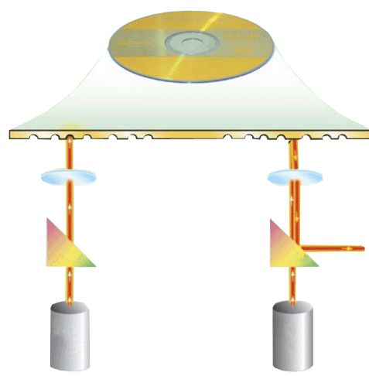
Optical Discs
How does a laser read data on an optical disc?
disc label
lens
pit
land
lens
Step 3. Reflected light is deflected to a light-sensing diode, which send a digital signals of 1 to computer. Absence of reflected light is read as a digital signal of 0.
0
Step 2. If light strikes a pit, it scatters. If light strikes a land, it is reflected back toward diode.
1
prism
prism
Step 1. Laser diode shines a light beam toward disc.
light- sensing diode
light- sensing diode
laser diode
laser diode
p. 367 Fig. 7-18
Next

Slide 23
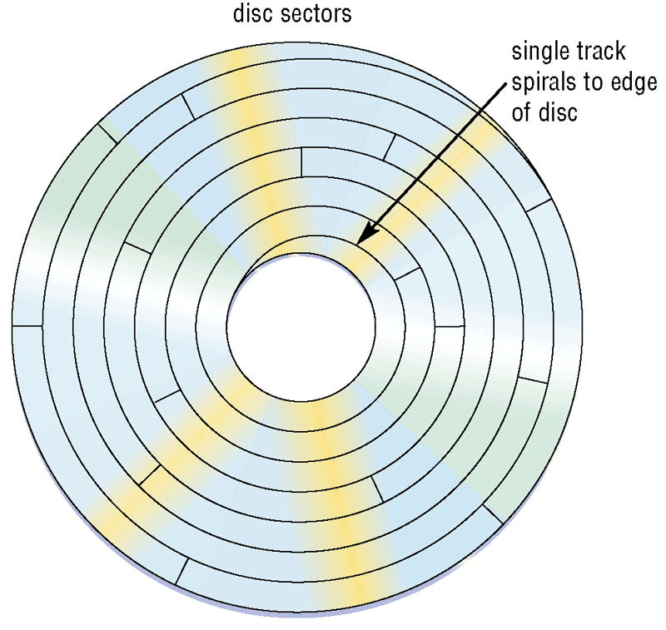
Optical Discs
How is data stored on an optical disc?
Typically stored in single track
Track divided into evenly sized sectors that store items
p. 367 Fig. 7-19
Next

Slide 24
Optical Discs
How should you care for an optical disc?
p. 368 Fig. 7-20
Next

Slide 25
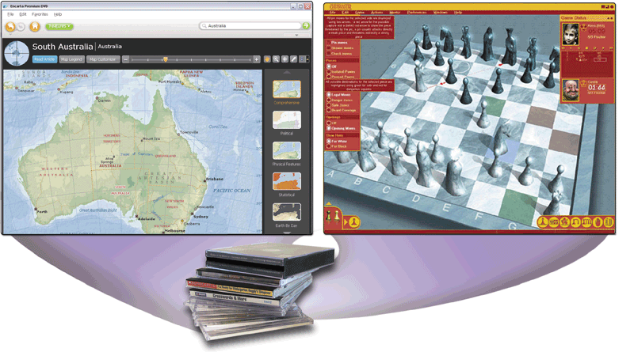
Optical Discs
What is a CD-ROM?
Compact disc read-only memory
Cannot erase or modify contents
Typically holds 650 MB to 1 GB
Commonly used to distribute multimedia and complex software
Click to view Web Link, click Chapter 7, Click Web Link from left navigation, then click CD-ROMs below Chapter 7
p. 369 Fig. 7-22
Next

Slide 26
Optical Discs
What is the data transfer rate of a CD-ROM drive?
Ranges from 48X to 75X or faster
75X
75 × 150 KBps = 11,250 KBps or 12.25 MBps
75X is 150 KBps (KB per second)
48X: 48 × 150 KBps = 7,200 KBps or 7.2 MBps
p. 369
Next

Slide 27
Optical Discs
What are CD-Rs and CD-RWs?
Must have CD recorder or CD-R drive
CD-R (compact disc-recordable)
—cdisc you can write on once
Cannot erase disc’s contents
CD-RW (compact disc-rewritable)
—ceerasable disc you can write on multiple times
Must have CD-RW software and CD-RW drive
Click to view Web Link, click Chapter 7, Click Web Link from left navigation, then click CD-Rs and CD-RWs below Chapter 7
p. 370
Next

Slide 28
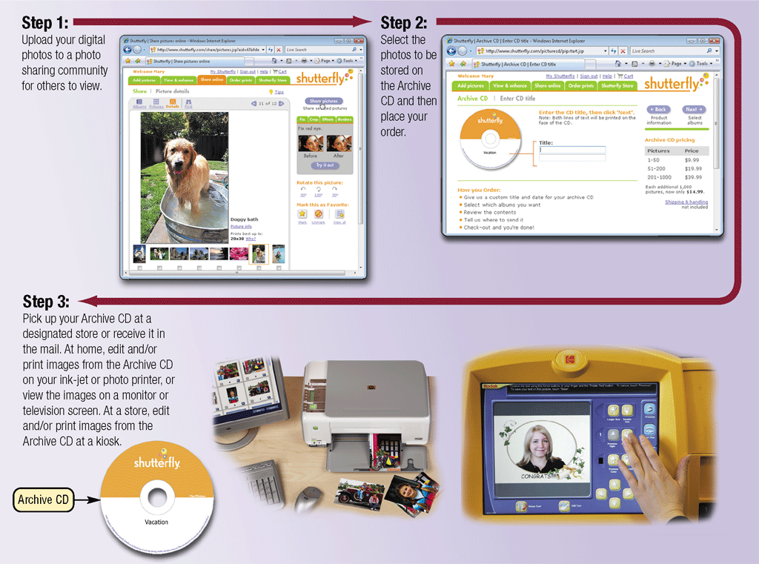
Optical Discs
What is an Archive CD?
Click to view Web Link, click Chapter 7, Click Web Link from left navigation,
then click Archive CDs below Chapter 7
p. 370 - 371 Fig. 7-23
Next

Slide 29

Optical Discs
Video: Got Your Video Right Here
CLICK TO START
Next

Slide 30
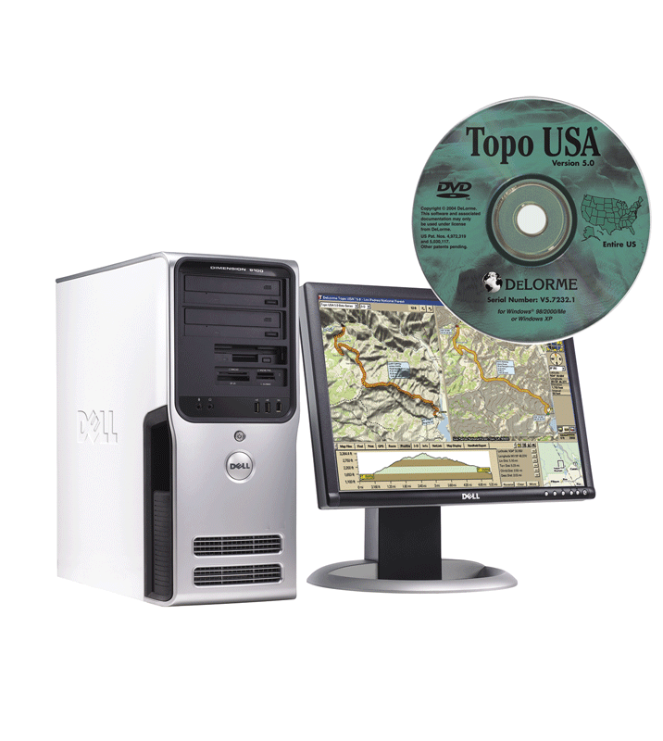
Optical Discs
What is a DVD-ROM (digital versatile disc-ROM or digital video disc-ROM)?
Must have DVD-ROM drive or DVD player to read DVD-ROM
Stores databases, music, complex software, and movies
Blu-ray discs have storage capacity of up to 100 GB
HD-DVD discs have storage capacity of up to 60 GB
HD-VMDs have storage capacity of up to 40 GB or more
UMD can store up to 1.8 GB
p. 372 Fig. 7-24
Next

Slide 31
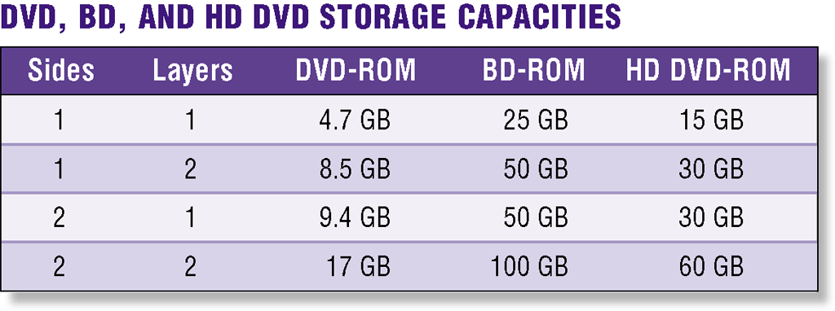
Optical Discs
How does a DVD-ROM store data?
Two layers of pits are used, lower layer is semitransparent so laser can read through
Some are double-sided
Many types of recordable and rewritable DVDs are available
DVD-R and DVD+R
DVD-RW, DVD+RW, and DVD+RAM
Click to view Web Link, click Chapter 7, Click Web Link from left navigation,
then click Blu-ray and HD DVD below Chapter 7
p. 372 - 373 Fig. 7-25
Next

Slide 32
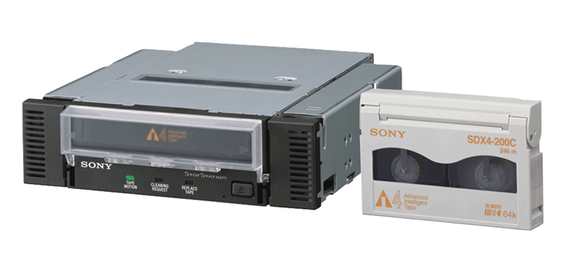
Tape
What is tape?
Magnetically coated plastic ribbon capable of storing large amounts of data at low cost
Primarily used for backup
p. 374 Fig. 7-27
Next

Slide 33
Tape
How is data stored on a tape?
Sequential access
Reads and writes data consecutively, like music tape
Unlike direct access — used on hard disks, CDs, and DVDs — which can locate particular item immediately
p. 374
Next

Slide 34
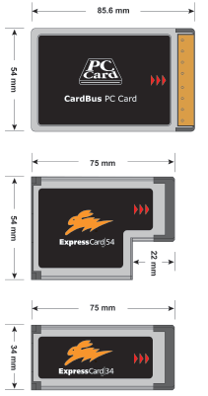
PC Cards and ExpressCard Modules
What are PC Cards and ExpressCard Modules?
Adds capabilities to computer
Credit-card-sized device commonly used in notebook computers
p. 374 Figs. 7-28
Next

Slide 35
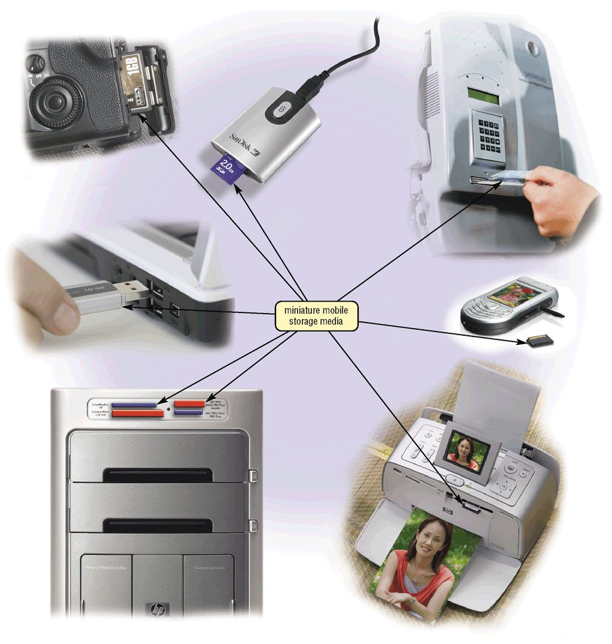
Miniature Mobile Storage Media
What is miniature mobile storage media?
Storage for small mobile devices
p. 375 Fig. 7-29
Next

Slide 36
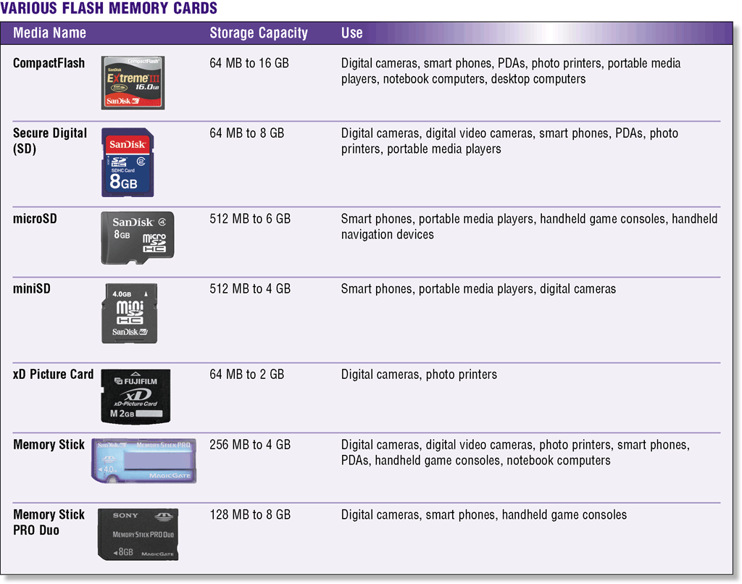
Miniature Mobile Storage Media
What are common types of flash memory cards?
Click to view Web Link, click Chapter 7, Click Web Link from left navigation, then click microSD Cards below Chapter 7
p. 376 Fig. 7-30
Next

Slide 37
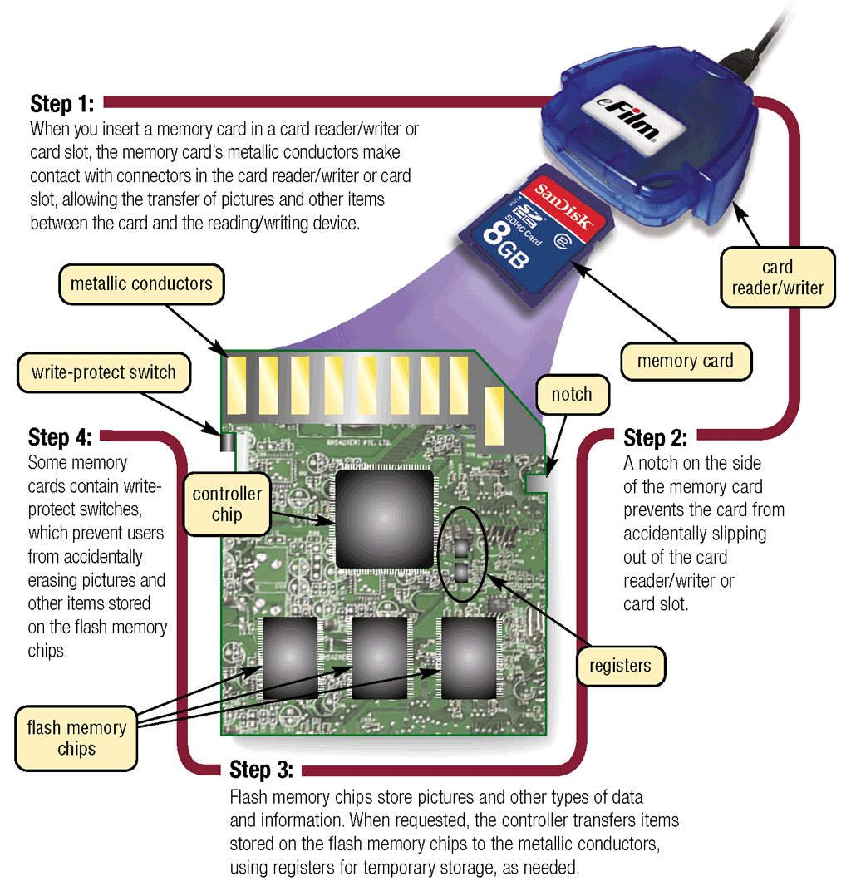
Miniature Mobile Storage Media
How does one type of flash memory card work?
p. 377 Fig. 7-31
Next

Slide 38
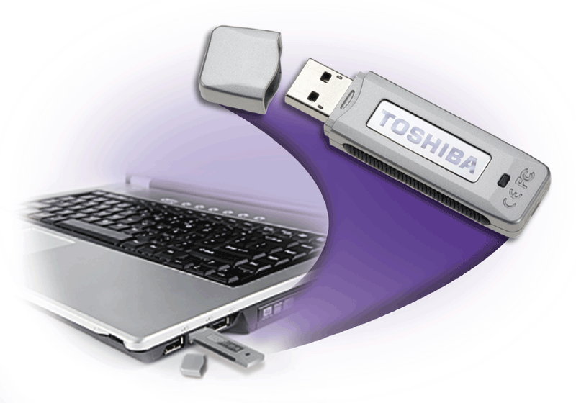
Miniature Mobile Storage Media
What is a USB Flash Drive?
Plugs in a USB port on a computer or mobile device
Storage capacities up to 64 GB
May eventually make the floppy disk nearly obsolete
Click to view Web Link, click Chapter 7, Click Web Link from left navigation, then click USB Flash Drives below Chapter 7
p. 377 Fig. 7-32
Next

Slide 39
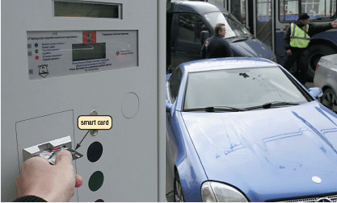
Miniature Mobile Storage Media
What is a smart card?
Stores data on microprocessor embedded in small card
Input, process, output, and storage capabilities
Click to view Web Link, click Chapter 7, Click Web Link from left navigation, then click Smart Cards below Chapter 7
p. 378 Fig. 7-33
Next

Slide 40
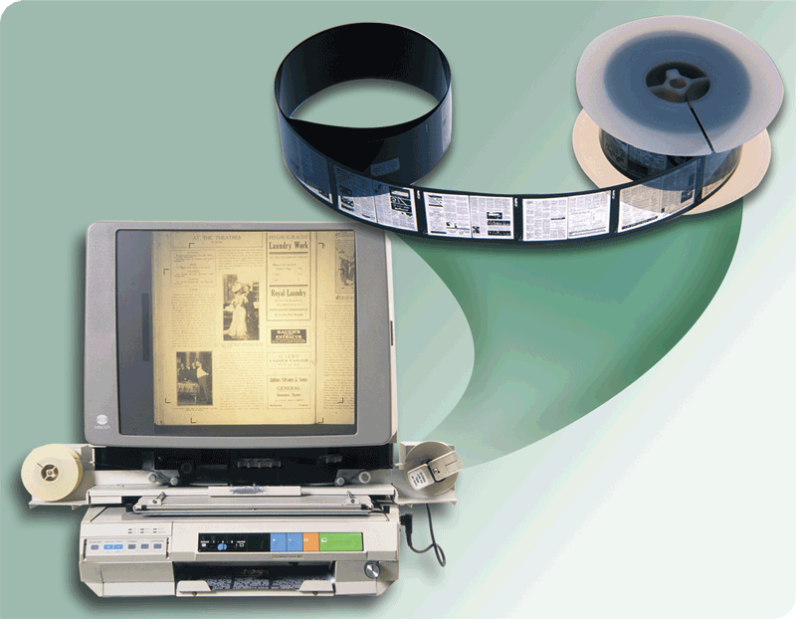
Microfilm and Microfiche
What are microfilm and microfiche?
Store microscopic images of documents on roll or sheet of film
Images recorded using computer output microfilm recorder
Microfilm — 100- to 215-foot roll of film
Microfiche — small sheet of film, usually 4” × 6”
p. 379 Fig. 7-34
Next

Slide 41
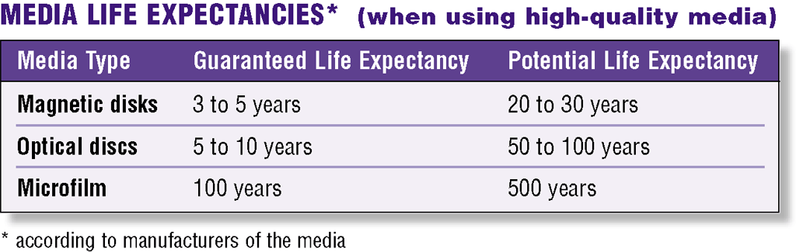
Microfilm and Microfiche
How do life expectancies of various media compare?
Microfilm and microfiche have longest life of any storage media
p. 379 Fig. 7-35
Next

Slide 42

Putting It All Together
What are recommended storage devices for home users?
320 GB hard disk
Online storage
CD or DVD drive
Card reader/writer
USB flash drive
p. 380 Fig. 7-37
Next

Slide 43

Putting It All Together
What are recommended storage devices for small office/home office (SOHO) users?
1 TB hard disk
Online storage
CD or DVD drive
External hard drive for backup
USB flash drive
p. 380 Fig. 7-37
Next

Slide 44

Putting It All Together
What are recommended storage devices for mobile users?
250 GB hard disk
Online storage
CD or DVD drive
Card reader/writer
Portable hard disk for backup
USB flash drive
p. 380 Fig. 7-37
Next

Slide 45

Putting It All Together
What are recommended storage devices for power users?
2.5 TB hard disk
Online storage
CD or DVD drive
Portable hard disk for backup
USB flash drive
p. 380 Fig. 7-37
Next

Slide 46

Putting It All Together
What are recommended storage devices for large business users?
Desktop computer
1 TB hard disk
CD or DVD drive
Smart card reader
Tape drive
USB flash drive
Server or Mainframe
Network storage server
40 TB hard disk system
CD or DVD server
Microfilm or microfiche
p. 380 Fig. 7-37
Next

Slide 47
Summary of Storage
Internal hard disks
HD DVD discs
External and removable hard disks
Recordable and Rewritable DVDs
Floppy disks
Tape
CD-ROMs
PC Cards and ExpressCard modules
Recordable and Rewritable CDs
Flash memory cards and USB flash drives
DVD-ROMs
Smart cards, microfilm, and microfiche
Blu-ray Discs (BDs)
Chapter 7 Complete

